Slide 1
Hadoop Distributed Filesystem (HDFS)
Lecture 3

Slide 2
HDFS Goals (1)
Dealing with hardware failure: An HDFS instance may consist of thousands of server machines each storing part of the file system data. Thus detection of faults and quick, automatic recovery from them is an architectural goal
Support Large Data Set: HDFS is designed to support large files. It should support tens of millions of files in a single instance
High throughput: HDFS is designed more for batch processing rather than interactive use. High throughput of data access rather than low latency of data access is the goal

Slide 3
HDFS Goal (2)
Don’t Move Data but Computation: it is more efficient if computation is executed near the data it operates on, particularly when the size of the data set is huge. This minimises network congestion and increases the overall throughput of the system
Have Simple Coherence model: have write once read many access model for files. A file once created, written and closed need not be changed except for appends and truncates. Appending the content to the end of the files is supported but cannot be updated at arbitrary point or random access. This assumption simplifies data coherency issues and enables high throughput
Portable: designed to be easily portable from one platform to another – built using the Java language

Slide 4
Hadoop Distributed Filesystem (HDFS) Architecture
HDFS can be made up of thousands of individual computers where the systems files are stored in directly attached disk drives
Each of these individual computers is a self-contained server with own memory, CPU, disk and installed OS (typically Linux, but Windows is supported too)
Hadoop cluster is made up of two classes of servers:
DataNode (or slave nodes) where data is stored & processed
NameNode (or master nodes) which manages the Hadoop cluster
The DataNode (slave node) raw data consists of the blocks stored on the node
The NameNode (master nodes) the raw data consists of metadata that maps data blocks to the files stored in HDFS

Slide 5
DataNode
Each data node (slave node) runs a background process named DataNode
This background process keeps track of the slices of data that the system stores on its computer
It regularly talks to the NameNode (master server for HDFS) to report on health and status of the locally stored data
Data blocks are stored as raw files in the local file system.
From users perspective you do not know which of the slave nodes has the pieces of the file you need to process.
From within Hadoop you do not see data blocks or how they are distributed across the cluster - you just see the listing of files in HDFS

Slide 6
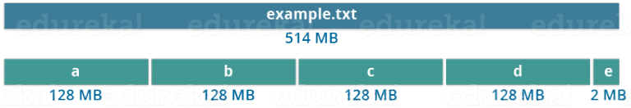
Blocks
Blocks are the smallest continuous location on your hard drive where data is stored
As in OS, you store the data as a collection of blocks. HDFS stores each file as blocks which are scattered throughout the Hadoop cluster
Each file is not stored in exact multiple of the configured block size (128 MB). eg

Slide 7
Design decisions of HDFS
Files stored in larger blocks: Many file systems store their information in blocks of 4 kilobytes (KB). HDFS blocks size default is 128 megabytes (MB) (previous version 64MB).
Large blocks reduce the overall number of blocks that must be maintained and also minimises overhead.
Reliability is achieved through replication- DataNodes to a default number of three.
A single master NameNode coordinates access and metadata and this simplifies and centralises management
No data caching as the data set is too large

Slide 8
Why are Data blocks (eg 128MB) so huge in HDFS?
HDFS deal with huge data sets eg Terabytes and Petabytes of data.
If we had a block size of 4 KB (as in Linux file system) we would be having too many blocks and therefore too much of the metadata
Managing these no of blocks and metadata will create huge overhead for the NameNode
HDFS is designed to enable high throughput so that the parallel processing of these large data happens. However, having too large a block size (10s GB) may make parallel processing slow and inefficient.
With less blocks, the file will be stored on less nodes and this reduces degree of parallel processing

Slide 9
Commodity Hardware for DataNode (Slave node)
Minimising the cost of the individual slave nodes by using commodity hardware eg £1000 vs £10000 (Commodity vs Enterprise server)
Important for massively scalable systems as you can have 1000’s of slave nodes
Slave nodes failures is a common occurrence in larger clusters with hundreds or more nodes
HDFS engineered on the assumption that all hardware components are unreliable
HDFS overcomes unreliability of individual hardware components by redundancy; each file block stored in HDFS has 3 replicas
If one system crashes with a specific file block you need there are the other two.

Slide 10
NameNode – the Address book for HDFS Cluster
NameNode is address book for HDFS because it knows not only which blocks make up individual files but also where each of these blocks and their replicas are stored
When a user stores a file in HDFS, the file is divided into data blocks. 3 copies of these data blocks are stored in slave nodes (DataNode) throughout the Hadoop cluster as dictated by NameNode
NameNode a critically important component in a Hadoop cluster and if it is unavailable applications cannot access any data stored in HDFS
HDFS is journaling file system; all meta data changes are logged in an edit journal that tracks events since the last checkpoint - the last time when the editlog was merged with fsimage.

Slide 11
NameNode details
Records the metadata of all the files stored in the cluster eg location of blocks stored, the size of the files, permissions, hierarchy
Two files associated with the metadata:
FsImage: contains the complete state of the file system namespace since the start of the NameNode
EditLogs: contains all the recent modifications made to the file system with respect to the most recent FsImage
It records each change that takes place to the file system metadata eg if a file is deleted in HDFS, the NameNode will record this in the EditLog.
It regularly receives a Heartbeat and a block report from all the DataNodes in the cluster to ensure that the DataNodes are healthy and alive

Slide 12
NameNode Details (cont)
Keeps a record of all the blocks in HDFS & in which nodes these blocks are located
Responsible to take care of the replication factor of all the blocks
In case of the DataNode failure, the NameNode chooses new DataNodes for new replicas, balance disk usage and manages the communication traffic to the DataNodes
User data never resides on the NameNode. The data resides on DataNodes only

Slide 13
NameNode details (Cont)
NameNode periodically receives Heartbeat and a Block report from each of the DataNodes in the cluster
Receipt of a Heartbeat means that the DataNode is functioning properly
A Blockreport contains a list of all blocks on a DataNode.
DataNode daemons send the NameNode heartbeats every 3 seconds indicating they are alive
By Default every 6 hours (configurable) the DataNodes send the NameNode a block report outlining which file blocks are on their nodes - Ensures NameNode has current view of the available resources in the cluster

Slide 14
NameNode details
NameNode executes file system operations like opening, closing, and renaming files and directories.
It determines the mapping of blocks to DataNodes
NameNode needs to know how many data blocks they need to process and to keep track of the exact location where they are stored it needs all the block locations and block-to-file mappings
To load all the information that the NameNode needs after it starts up, the following happens:
NameNode loads the fsimage file into memory.
NameNode loads the edits file and re-plays the journaled changes to update the block metadata that is already in memory.
The DataNode background process send the NameNode block reports

Slide 15
NameNode persistence
NameNode uses transaction log called the EditLog to persistently record every change that occurs to file system metadata Eg creating a new file in HDFS causes the NameNode to insert a record into the EditLog or changing the replication factor of a file causes a new record to be added into the EditLog.
The entire file system namespace including the mapping of blocks to files and file system properties is stored in a file called the FsImage.
The EditLog and FsImage is stored as a file in the NameNode local file system
Write-ahead logging as used in DBMS

Slide 16
NameNode Persistence
NameNode keeps an image of the entire file system namespace and file Blockmap in memory
When the NameNode starts up (or at checkpoint) it reads the FsImage and EditLog from disk, applies all the transactions from the EditLog to the in-memory representation of the FsImage and flushes out this new version into a new FsImage on disk.
It then truncate the old EditLog because its transactions have been applied to the persistent FsImage. This process is called a Checkpoint.
The purpose of a checkpoint is to make sure that HDFS has a consistent view of the file system metadata by taking a snapshot of the file system metadata and saving it to FsImage.
Inefficient to make incremental edits directly to a FsImage - we persist the incremental changes in the Editlog.
A checkpoint can be triggered at given time interval expressed in seconds, or after certain no of filesystem transactions have occurred in editlog.
the first threshold to be reached triggers a checkpoint.

Slide 17
Secondary NameNode
Secondary NameNode works concurrently with the primary NameNode as a helper daemon
It constantly reads all the file systems and metadata from memory of the NameNode and writes it into disk
Combines the EditLogs with FsImage from the NameNode
Downloads the EditLogs from the NameNode at regular intervals and applies to FsImage. The new FsImage is copied back to the NameNode
Secondary NameNode performs regular checkpoints in HDFS - it is also called CheckpointNode.

Slide 18
Checkpointing updates
The NameNode does not do the Checkpoint process because it is designed to answer application requests as quickly as possible.
There is considerable risk involved in having this metadata update operation managed by a single master server
HDFS is a journaled file system where new changes to files in HDFS are recorded in an edit log that is stored on the NameNode in a file named edits
Periodically when the edits file reaches a certain threshold or after a certain time the journaled entries need to be committed to the master fsimage file

Slide 19
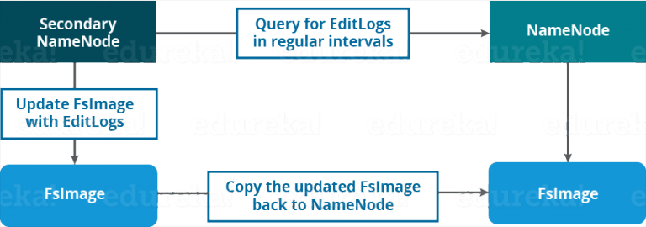

Slide 20
HDFS uses Replication to store Big Data in a reliable manner
Blocks are replicated to provide fault tolerance.
Default replication factor is 3 which is configurable (each block is replicated 3 times and stored on different DataNodes)
A file of 128 MB in HDFS using the default config will end up occupying a space of 384 MB (3*128 MB) as the blocks will be replicated 3 times and each replica will be residing on a different DataNode.
The NameNode collects block report from DataNode periodically to maintain the replication factor
If a block is over replicated or under replicated the NameNode deletes or add replicas as required

Slide 21
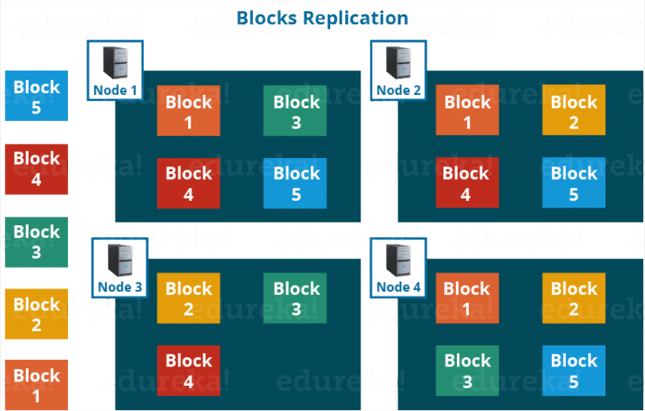

Slide 22
Rack Awareness
NameNode ensures all replicas are not stored on the same rack
Aim to reduce to reduce latency and provide fault tolerance
With replication factor of 3, the Rack Awareness Algorithm says that the first replica of a block will be stored on a local rack and the next two replicas will be stored on a different remote rack but, on a different DataNode within that (remote) rack
If a new Block is created, the 1st copy is stored on the local node, the 2nd on a different rack and 3rd is on a different node at the same rack
This approach improves write performance as it cuts the inter rack write traffic.
The chance of rack failure is far less than of node failure

Slide 23
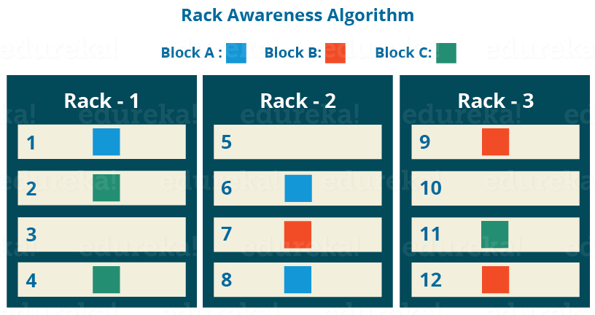

Slide 24
Rack awareness
The servers in a single rack share power and a network switch
Certain types of system failures are more likely to occur together across several nodes at once eg loss of a network switch or loss of power to a group of servers
Without Rack Awareness we can have all 3 copies of HDFS files are located on nodes in the same rack and a single power failure would make all copies unavailable
Can specify one copy of data to live in an entirely separate data center to ensure availability in case of data centre outage. This ensures availability even during a complete data center outage
Can use Rack Awareness to cluster nodes together instead of spreading them out to minimise latency between nodes in high performance applications

Slide 25
HDFS Read Write Architecture
Follows Write Once – Read Many approach
You cannot edit files already stored in HDFS but can append new data by re-opening it
Why?
To minimise network bandwidth consumption and read latency, HDFS tries to satisfy a read request from a replica that is nearest to the reader
If there exists a replica on the same rack as the reader node, then that replica is preferred for the read request

Slide 26
Write Architecture – suppose you want to write a file cool.txt of size 240MB
HDFS client will contact NameNode for a Write Request against the two blocks, say Block A (128MB) & Block B (112MB)
NameNode will then grant the client write permission and will provide the IP addresses of the DataNodes where the file blocks will be copied
The client has a time limit to complete the creation task and this time limit ensures that storage space is not taken up by failed client application
The selection of IP addresses of DataNodes is purely randomised based on availability, replication factor and rack awareness
With replication factor set to default 3 for each block the NameNode will provide the client list of 3 IP addresses of DataNodes. The list will be unique for each block.

Slide 27
Write Architecture (Continued)
Each block will be copied in three different DataNodes to maintain the replication factor
The whole data copy process will happen in three stages:
Set up of Pipeline
Data streaming and replication
Acknowledgement

Slide 28
1 - Setting up pipeline
Client creates a pipeline for each of the blocks by connecting the individual DataNodes
For block A, the client perform the following to create a pipeline:
Client will choose the first DataNode in the list (DataNode IPs for Block A) which is say DataNode 1 and establish a TCP/IP connection
The client will inform DataNode 1 to be ready to receive the block and will also provide the IPs of next two DataNodes (say 4 and 6) to the DataNode 1 where the block is supposed to be replicated.
DataNode 1 will connect to DataNode 4. The DataNode 1 will inform DataNode 4 to be ready to receive the block and will give it the IP of DataNode 6. Then DataNode 4 will tell DataNode 6 to be ready for receiving the data.
Acknowledgement of readiness will follow the reverse sequence - From the DataNode 6 to 4 and then to 1.
Then DataNode 1 will inform the client that all the DataNodes are ready and a pipeline will be formed between the client, DataNode 1, 4 and 6

Slide 29
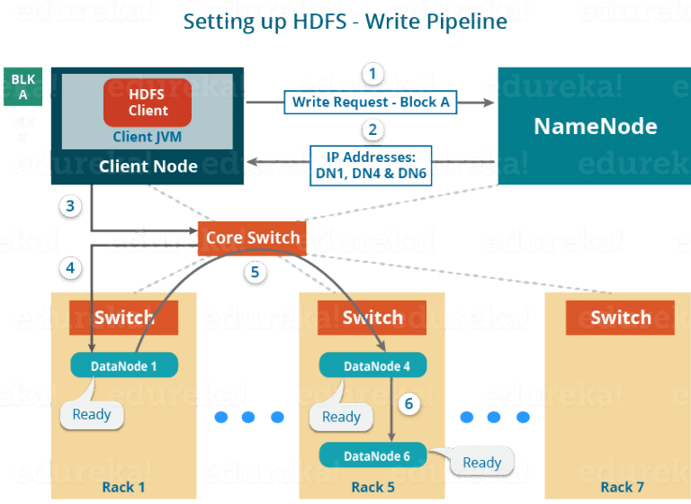

Slide 30
2. Data Streaming - Client will push the data into the pipeline
Following will take place during replication
Block is written to DataNode 1 by Client and DataNode 1 will connect to DataNode 4.
DataNode 1 will push the block in the pipeline and data will be copied to DataNode 4
DataNode 4 will connect to DataNode 6 and will copy the last replica of the block

Slide 31
3. Acknowledgement
When the block has been copied into 3 DataNodes, acknowledgements take place to tell the client and NameNode that the data has been written successfully
The Client will then close the pipeline to end the TCP session.
Acknowledgement happens in the reverse sequence ie from DataNode 6 to 4 and then to 1. DataNode 1 will push three acknowledgements (including its own) into the pipeline and send it to the Client
The client will inform NameNode that data has been written successfully
The NameNode will update its metadata and the client will shut down the pipeline

Slide 32
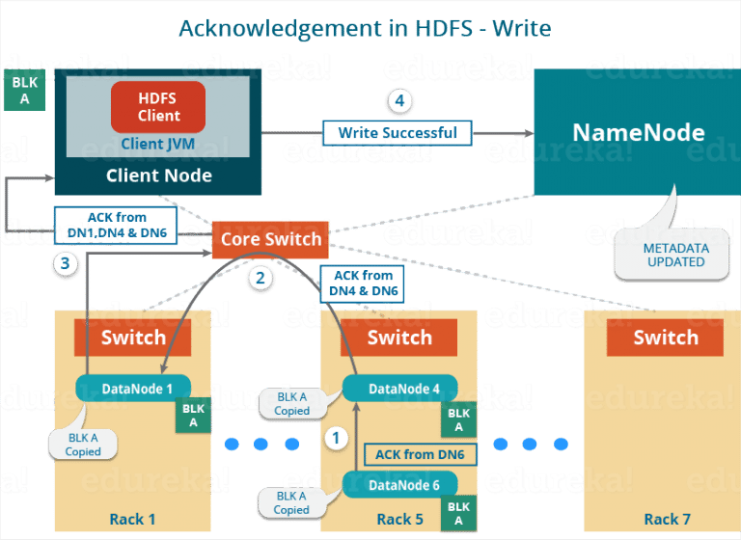

Slide 33
HDFS Write occur in parrallel
Continuing our example, Block B (size 112MB) will also be copied into the DataNodes in parallel with Block A (128MB). Therefore:
The client will copy Block A and Block B to the first DataNode simultaneously
2 pipelines will be formed for each of the block & all the process discussed will happen in parallel in these 2 pipelines.
The client writes the block into the first DataNode & then the DataNode will be replicating the block in a sequential manner

Slide 34
HDFS Read – Suppose you now want to read file cool.txt
Client asks the NameNode for the block metadata for file “cool.txt”.
The NameNode will return the list of DataNodes IP address where each block (Block A, B) are stored. It selects the replica which is closest to the client in order to reduce read latency and the network bandwidth usage.
The client will connect to the DataNodes where the blocks are stored
The client starts reading data parallel from the DataNodes (Block A from DataNode 1 and Block B from DataNode 3)
Client will combine these blocks to form a file once it gets it all

Slide 35
Balancing data in the Hadoop cluster
Over time data can become unevenly distributed across the racks and DataNode due to uneven data ingestion patterns where some Datanodes might have more data written to them or node failures
Uneven distribution will have a negative effect on performance because the demand on individual Datanodes will be uneven:
DataNodes with little data will not be fully utilised and ones with many blocks will be over utilised ie overuse and underuse are based on disk activity
HDFS has a balancer utility to redistribute blocks from overused datanodes to underused ones while maintaining the policy of putting blocks on different datanodes and racks. It should be run regularly

Slide 36
Namenode server design
NameNode is mission critical and needs markedly different hardware requirements than the ones for a DataNode
Enterprise level components need to be used to minimise the probability of an outage - low failure rates to maximise server uptime
You need enough RAM to load into memory all the metadata and location data about all the data blocks stored in HDFS
To ensure High availability, should have an active NameNode and a standby NameNode

Slide 37
HDFS Fault Tolerance – Standby NameNode
To ensure there is no single point of failure in NameNode there should be Standby NameNode
Standby NameNode should configured identically to the master node used by the Active NameNode
Standby NameNode is not sitting idly by while the NameNode handles all the block address requests. The Standby NameNode has the task of keeping the state of the block locations and block metadata in memory, handles the HDFS checkpointing responsibilities.
In case of failure, the Standby Node first reads all completed journal entries to ensure that the new Active NameNode is fully consistent with the state of the cluster
Apache Zookeeper monitors the Active NameNode and handles failover process if the Active NameNode becomes unavailable. Both the Active and Standby NameNodes have dedicated Zookeeper Failover Controllers that perform the monitoring and failover tasks

Slide 38
Data integrity
A block of data fetched from DataNode can arrive corrupted because of faults in storage device, network faults, defective software
Client software implements checksum checking on the contents of HDFS files.
When a client creates a file it computes a checksum of each block of the file and stores these checksums in a separate file in the same HDFS namespace
When a client retrieves file contents it checks that the data it received from each DataNode matches the checksum stored in the associated checksum file
If it does not, the client can retrieve that block from another DataNode that has a replica of that block

Slide 39
HDFS Compression
Compression is required due to the huge data volumes that exist in in a typical Hadoop deployment
Data compression saves on storage space and speeds up movement of that data throughout cluster
A codec, which is a shortened form of compressor/ decompressor, is technology for compressing and decompressing data
When compressing data you are exchanging CPU cycles for disk space. There is a cost (in terms of processing resources and time) associated with compressing the data that is being written
Filename extension will tell Hadoop which compress/decompressor to use eg gzip

Slide 40
HDFS - traditional hierarchical file organisation
HDFS supports a traditional hierarchical file organisation eg like in Linux.Windows
User or an application can create directories and store files inside these directories.
Can create and remove files, move a file from one directory to another, or rename a file. HDFS supports user quotas and access permissions
NameNode maintains the file system namespace and records any change to the file system namespace or its properties

Slide 41
Managing files with hadoop file system commands
A distributed file system is a file system that manages storage across a networked cluster of machines.
HDFS stores data in blocks, units whose default size is 128MB. Files that you want stored in HDFS need to be broken into block-size chunks that are then stored independently throughout the cluster
The Hadoop file system shell commands, which are similar to Unix/Linux file commands, have the following general syntax:
hdfs dfs -cmd
Please see https://hadoop.apache.org/docs/r2.7.1/hadoop-project-dist/hadoop-hdfs/HDFSCommands.html

Slide 42
Working With HDFS
HDFS provides a set of commands that can be used at the console
General form of the commands:
hdfs dfs –cmd <args>
Commands very similar to Linux commands e.g. to list files on the HDFS
hdfs dfs –ls
Host operating system (Linux) can not manipulate HDFS files directly

Slide 43
HDFS Basic File Commands
Data to be processed by Hadoop must be loaded on to the HDFS first
hdfs dfs –put sample.txt
Data can be retrieved from the HDFS using
hdfs dfs –get sample.txt
Copies file to HDFS
home directory
Copies file to current
directory of local
file system

Slide 44
HDFS Basic File Commands
To list files on HDFS
hdfs dfs –ls
To delete files from HDFS
hdfs dfs –rm
To remove a directory containing files from HDFS
hdfs dfs –rm -r
Remove recursively

Slide 45
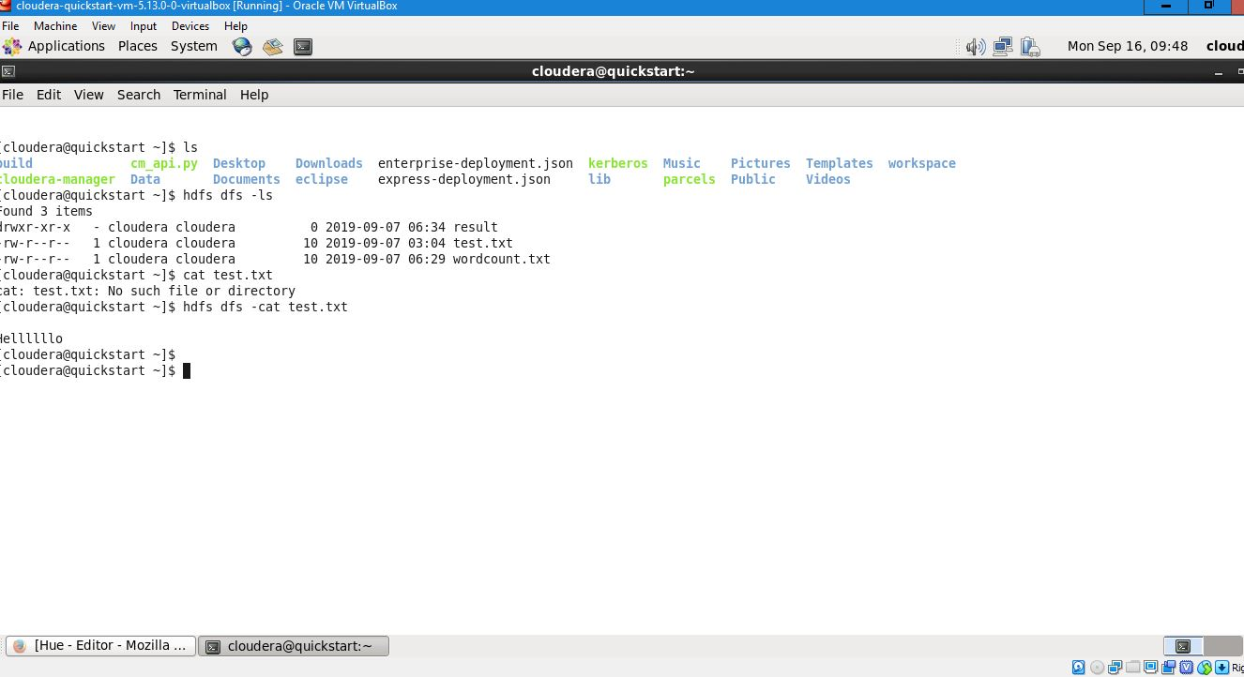
Local vs Distributed filesystem

Slide 46
Hadoop Modes
Pseudo-Distributed Mode
Uses HDFS
One node (machine) will be used as Name Node / Data Node / Job Tracker / Task Tracker
Cluster nodes simulated by daemons (separate processes) that all run on one machine
Fully Distributed Mode
Requires real cluster of machines
Data distributed across many nodes.
Different Nodes will be used as Name Node / Data Node etc

Slide 47
Installing Hadoop on your PC
Hadoop is designed to be deployed on a large cluster of networked computers with master nodes and slave nodes. However, you can run Hadoop on a single computer to help to learn the basics of Hadoop
Hadoop has two deployment modes: pseudo-distributed mode and fully distributed mode
To download on your PC: https://www.cloudera.com/downloads/quickstart_vms/5-13.html
Useful tips: https://community.cloudera.com/t5/Community-Articles/How-to-setup-Cloudera-Quickstart-Virtual-Machine/ta-p/35056

Slide 48
Data Ingestion
Is a process by which data is moved from one or more sources to a destination where it can be stored and further analysed.
Data can be in different formats and come from various sources, including RDBMS, CSVs, from streams etc.
Some of the data that ends up in HDFS might land there via database load operations or other types of batch processes
Apache Flume (a project from the Apache Software Foundation) is a distributed system for aggregating and moving large amounts of streaming data from different sources to a centralised data store. Flume is designed for the continuous ingestion of data into HDFS. The data can be any kind of data, but Flume is particularly well suited to handling log data, such as the log data from web servers

